Slide 1
Poetics, Principles, and Histories of Parser-Based Interactive Fiction
Nick Montfort
Prof of Digital Media, MIT
https://nickm.com
nickm@nickm.com

Slide 2
Some historical context...

Slide 3

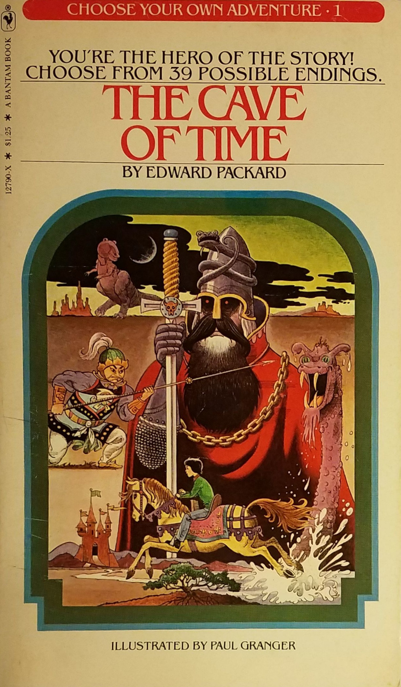
1963
1979

Slide 4
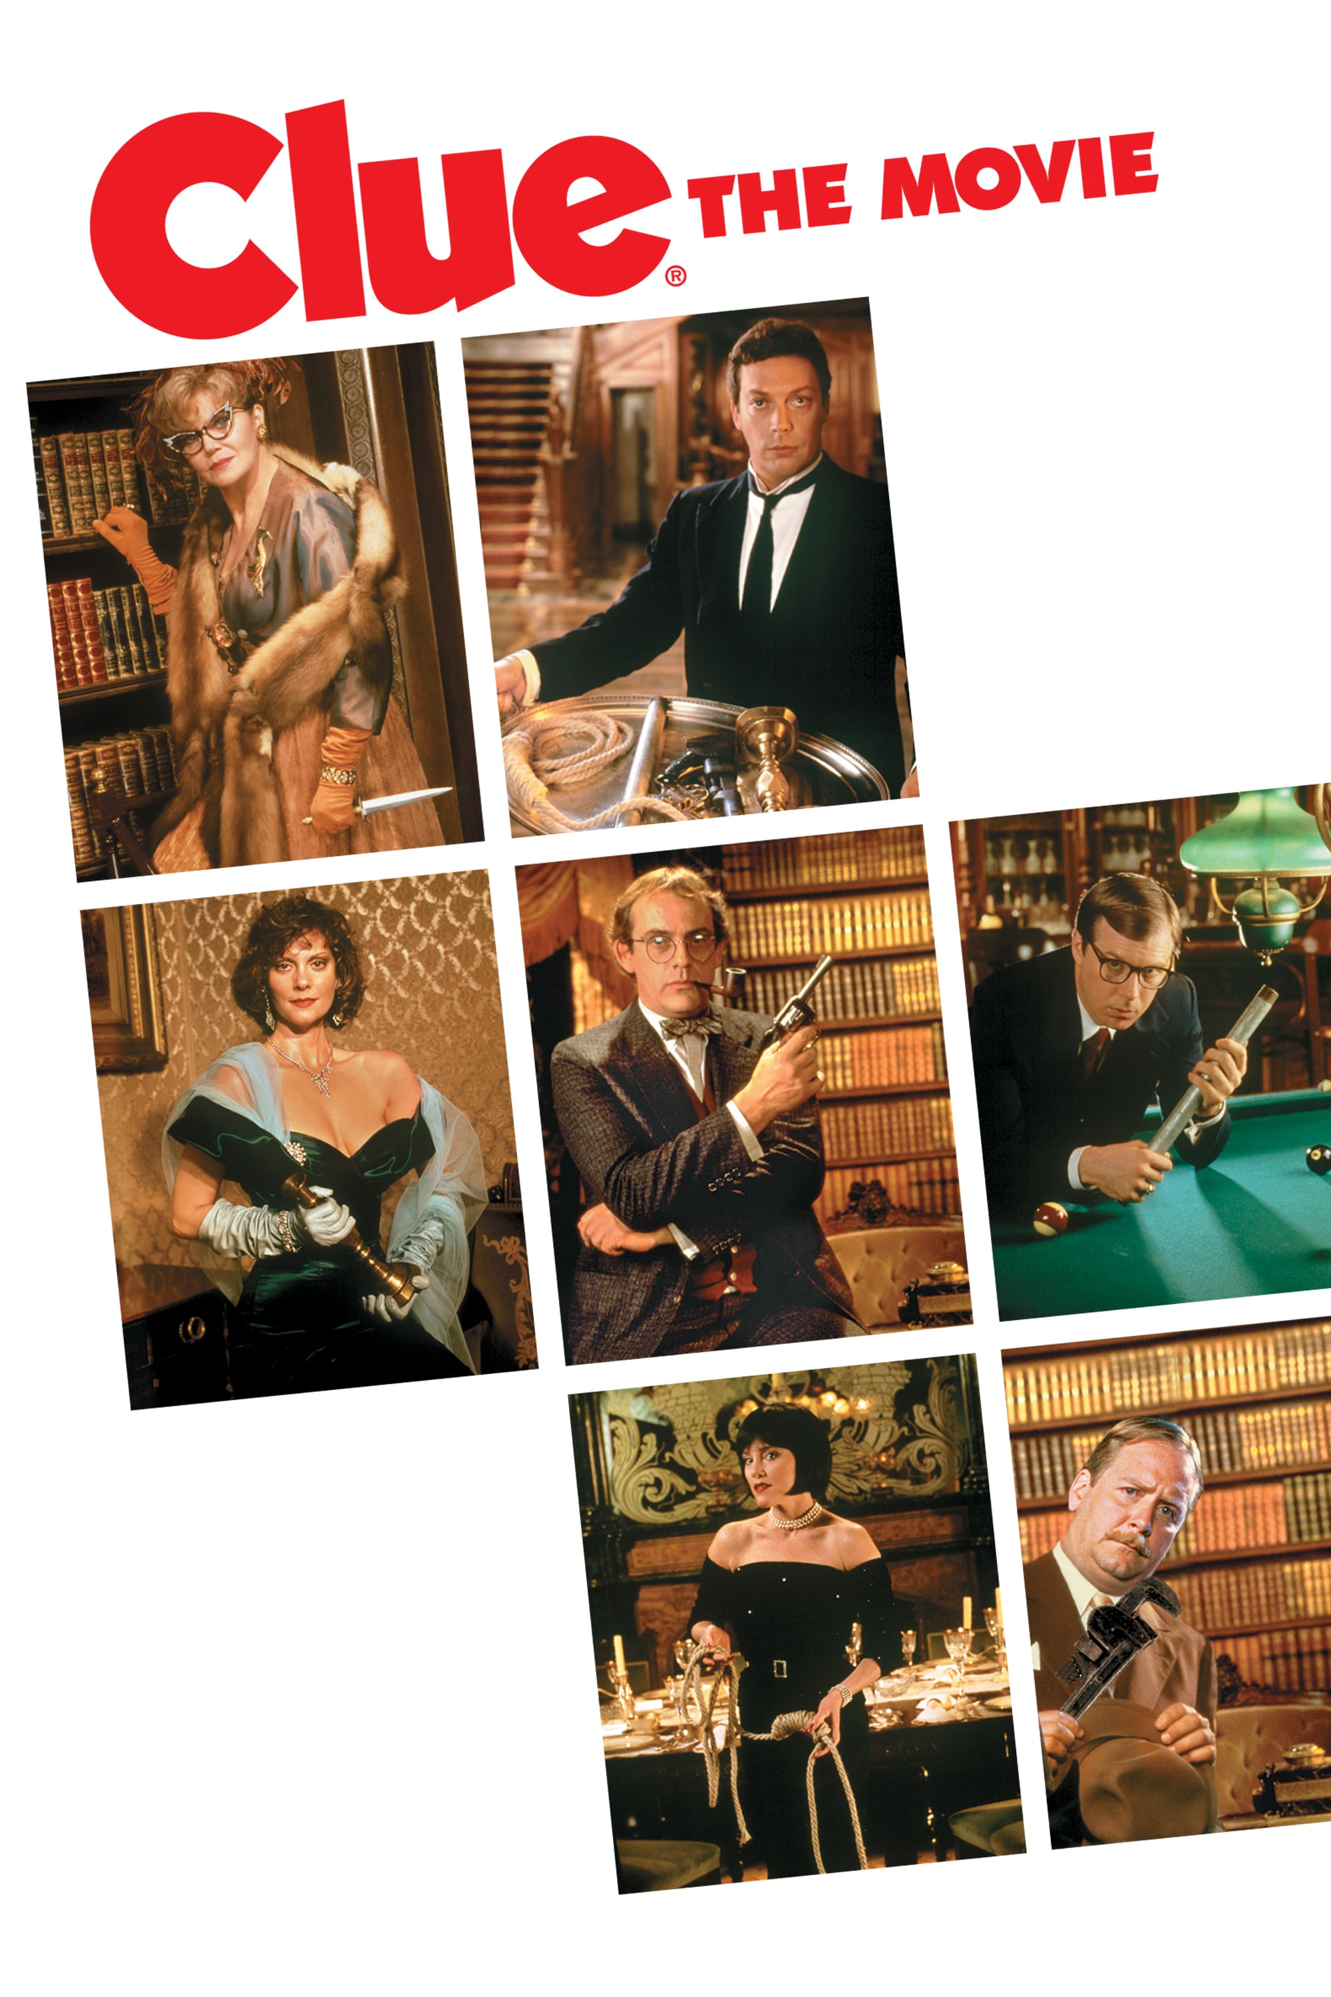
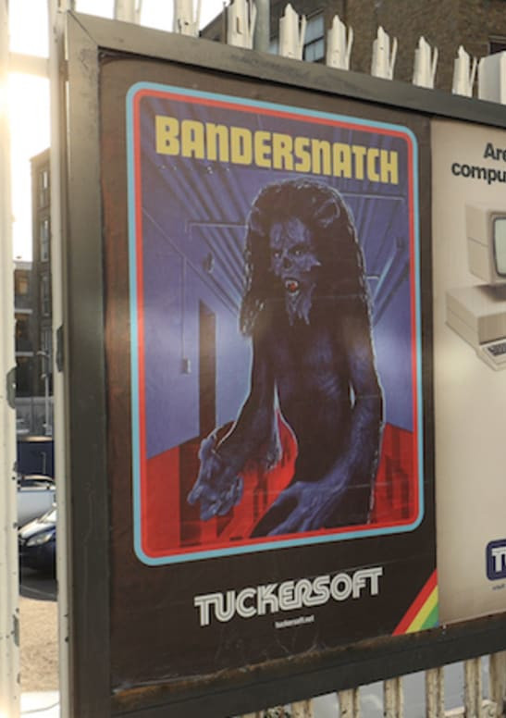
1985
2018

Slide 5
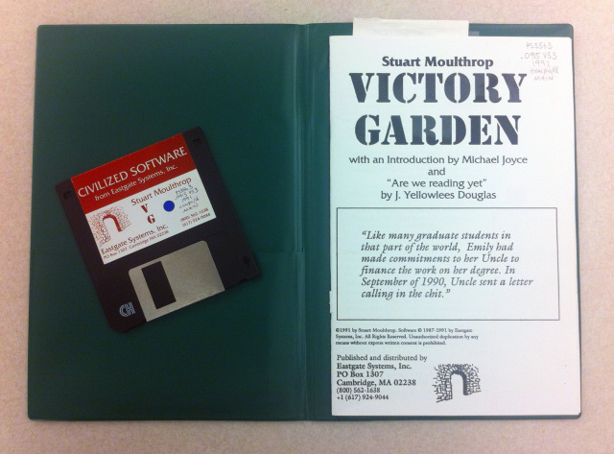
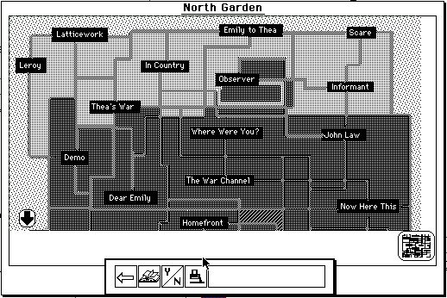
1992

Slide 6
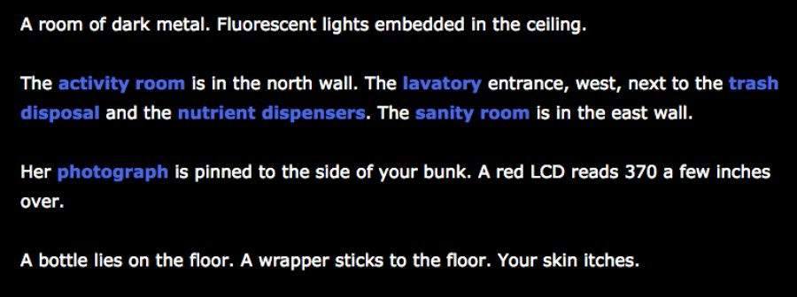
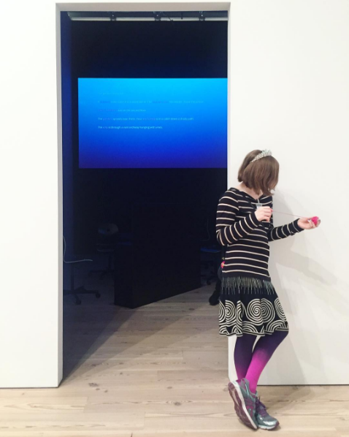
2012
2017

Slide 7
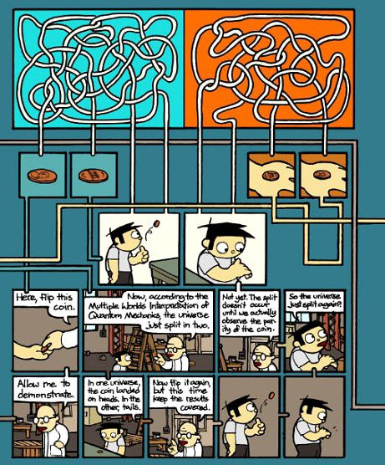
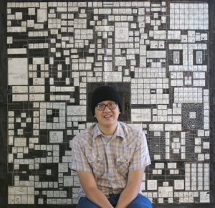
2010

Slide 8

2011

Slide 9

2012

Slide 10
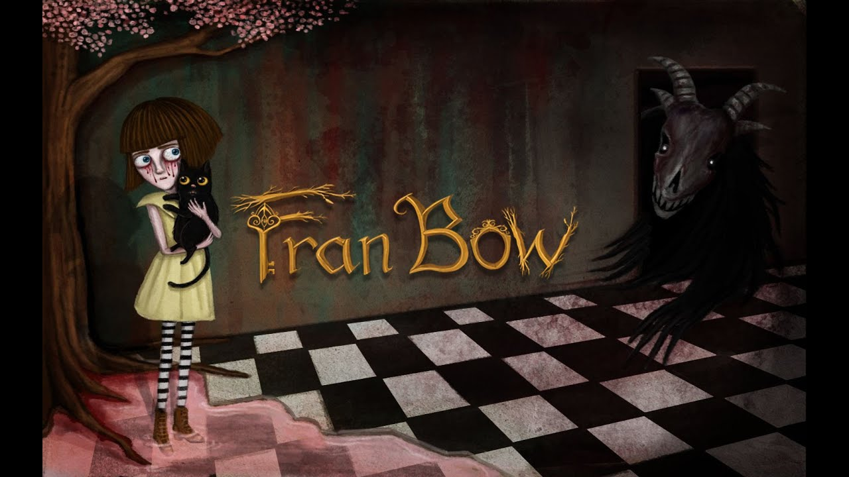
2015

Slide 11

2018

Slide 12
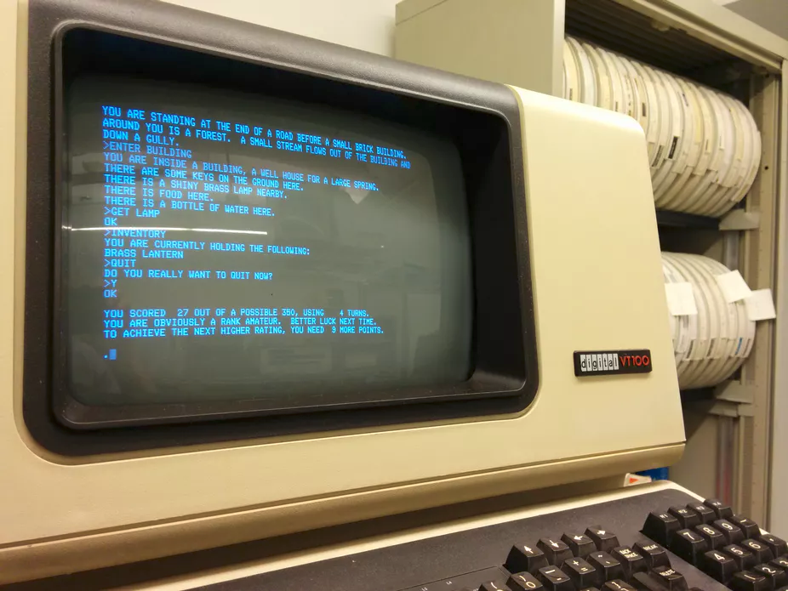
1975–1977

Slide 13
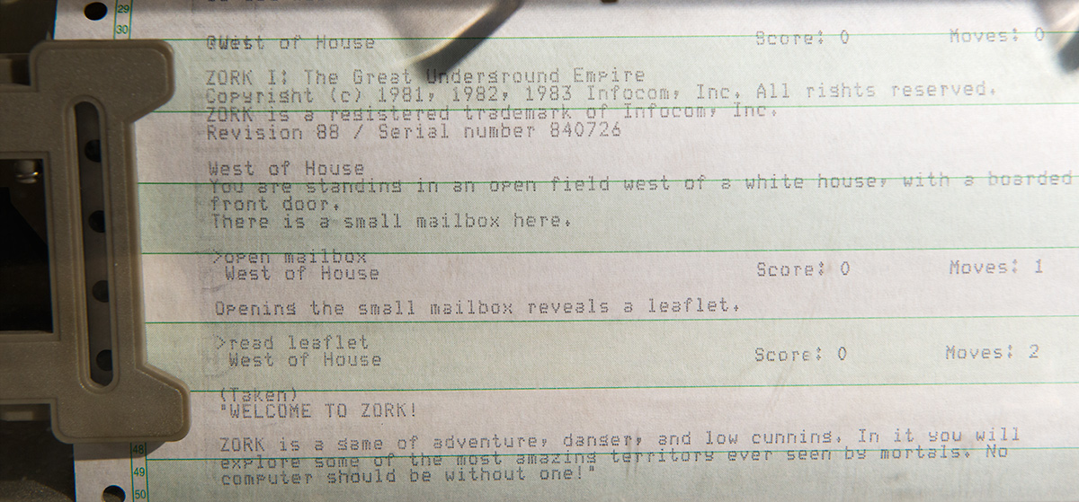
1977–1979

Slide 14
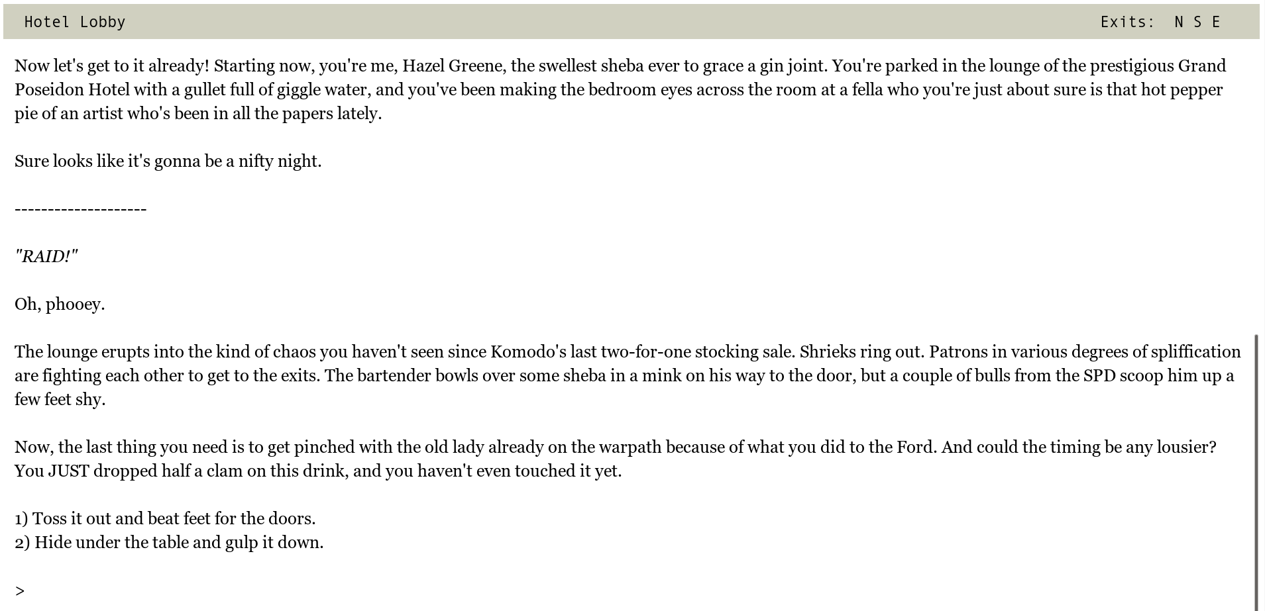
2019

Slide 15
Novels, Gamebooks, Interactive Movies, Interactive Streaming Video, Hypertext, Comics, Visual Novels, Franchise Serial Video Games, Indie Video Games, AAA Video Games …
Parser-Based Interactive Fiction/
Text Adventures

Slide 16
Interactivity

Slide 17


Slide 18
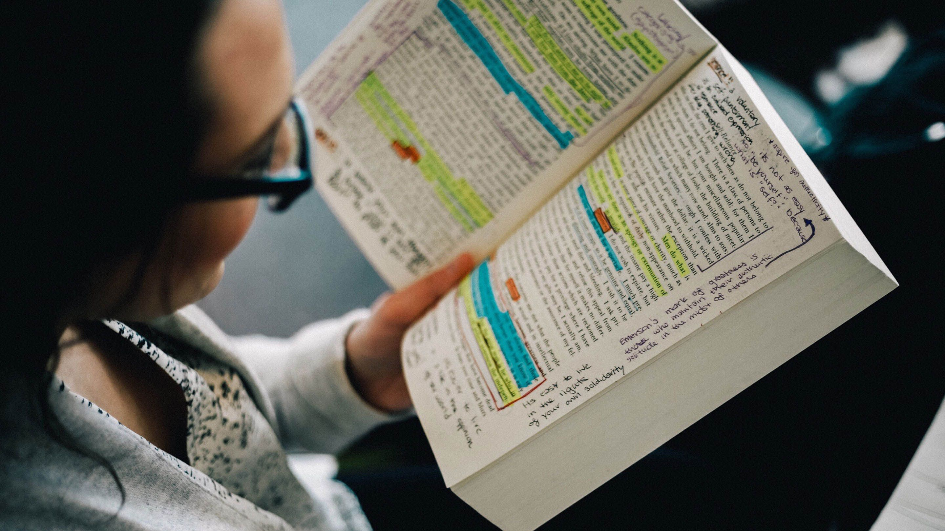

Slide 19

Espen Aarseth, 1997

Slide 20
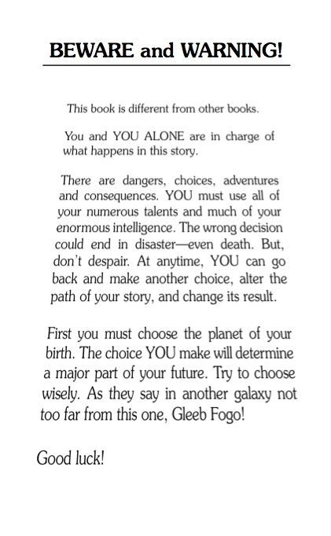

Slide 21
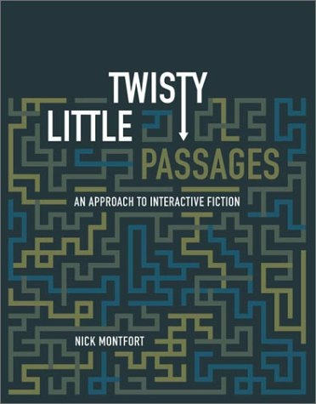
Me, 2003

Slide 22
I like to see it lap the Miles -
And lick the Valleys up -
And stop to feed itself at Tanks -
And then - prodigious step
Around a Pile of Mountains -
And supercilious peer
In Shanties - by the sides of Roads -
And then a Quarry pare
To fit its sides
And crawl between
Complaining all the while
In horrid - hooting stanza -
Then chase itself down Hill -
And neigh like Boanerges -
Then - prompter than a Star
Stop - docile and omnipotent
At it's own stable door -

Slide 23
Once cloud, now all memory my motion.
Amorphous creeping slow as sleep to a full
black gulping flood. The small five-fingered
blot enlarged beyond identity. Heavy, unslaked,
still hunting form. The hiding place,
the necessary horror.

Slide 24
Narrative

Slide 25
Are these narratives? Consult your questionnaire!

Slide 26
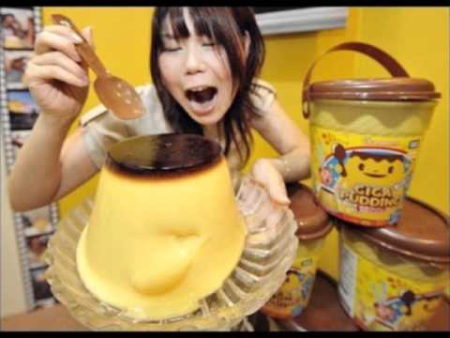

Slide 27
Narrative:
A representation of one
or more events in sequence.
(A simple formalist definition.)

Slide 28
Story (in the most usual sense):
A narrative with a point.

Slide 29

Livia Polanyi, 1989

Slide 30
Narrative ≠Life!
It’s a representation.
It can be varied and told in different ways.

Slide 31
Expression
Content

Slide 32
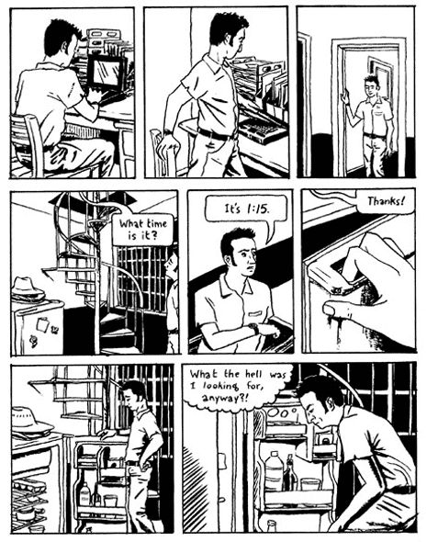
Matt Madden, 99 Ways to Tell a Story

Slide 33
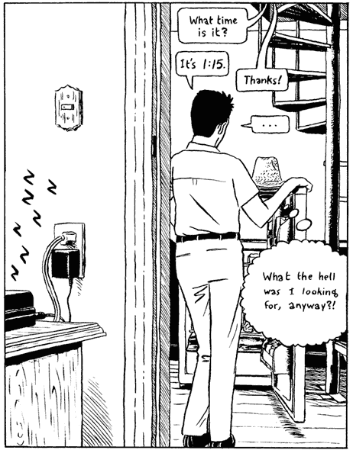
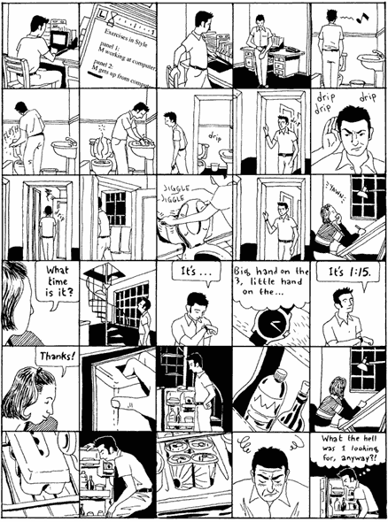

Slide 34
Narrative tense —
Order
Speed
Frequency
Narrative mood —
Distance
Focalization
Narrative voice —
Time of narrating
Narrator & narratee
Gérard Genette,
Narrative Discourse
1980 (1972)

Slide 35
Order
expr 1
expr 2
John eats
sandwich
John dies
expr 1
expr 2
John eats
sandwich
John dies

Slide 36
Speed
expr 3
expr 1
expr 3
expr 1
expr 2
expr 2
John eats
sandwich
John eats
sandwich
John goes outside
John goes outside
John dies
John dies
expr 1
expr 1
expr 3
expr 2
John eats
sandwich
John eats
sandwich
John goes outside
John goes outside
John dies
John dies

Slide 37
Frequency
expr 1
expr 2
John eats
sandwich
John dies
expr 1
expr 2
expr 3
expr 4
John eats
sandwich
John dies

Slide 38
Order, Speed, & Frequency
expr 1
expr 2
expr 3
King dies
Queen grieves
Queen dies
Mime
seizes
power
Jester laughs

Slide 39
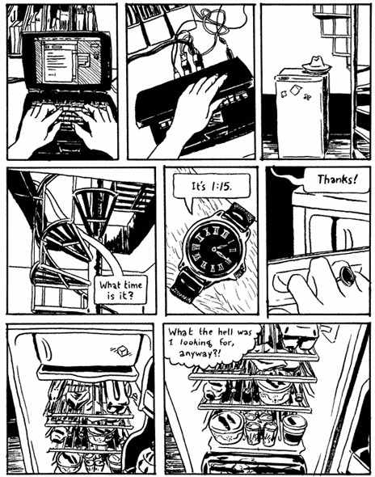
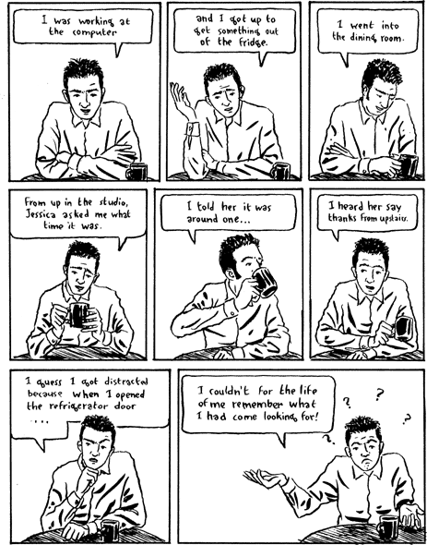
Focalization
Distance

Slide 40
Time of Narrating
The king dies and then the queen dies of grief.
The king died and then the queen died of grief.
The king will die and then the queen will die of grief.
The king dies — the queen will die of grief.

Slide 41
Narrator
I laughed after the mime seized power.
The jester laughed after I seized power.
The jester laughed after the mime seized power.

Slide 42
Narratee
You laughed after the mime seized power.
The jester laughed after you seized power.
The jester laughed after the mime seized power.

Slide 43
Time of Narrating, Narrator & Narratee
The king dies, the queen dies of grief, you seize power and I laugh.
I died. Then the queen died of grief, a mime seized power and my jester laughed.
The king will die, you will die of grief, a mime will seize power and the jester will laugh.

Slide 44
Narrative tense —
Order
Speed
Frequency
Narrative mood —
Distance
Focalization
Narrative voice —
Time of narrating
Narrator & narratee
Gérard Genette,
Narrative Discourse
1980 (1972)

Slide 45
Expression
Content

Slide 46
Very Brief Examples
(although we may discuss something else)

Slide 47
Tony stared into the empty glass. He ran his fingers through his hair and checked his watch.
“Don’t worry” the barman said, “She’ll be here.”
“Waiting” by Rob Metcalfe http://www.the-phone-book.com/version13/storypages.php?ID=76

Slide 48
“Let down your hair!” he said. So she did. In no time at all she was entertaining men in her bedroom ...
“Rapunzel” by Kate Mahon http://www.the-phone-book.com/version13/storypages.php?ID=124

Slide 49
“I can’t believe that you’re making me do this,” said the mime.
https://www.cddc.vt.edu/journals/newriver/08Fall/ten_mobile_texts.html

Slide 50
Nick Montfort
Professor of Digital Media, MIT
Professor II, University of Bergen
nickm.com
nickm@nickm.com

